Slide 1



Fear and Comfort Index and Implementation
Yourik Hacoupian
Derrick Claye
Alice Lin
Sheldon Larmond

Slide 2
Objectives
Unsupervised
Creating a fear and comfort index.
Supervised
Train a model in order to predict the movement of the S&P 500.
Research Question
Can a Fear and Comfort Index be used to predict future movements of the stock market?

Slide 3
Data Collection and Analysis
Sentiment Analysis
Covid Stats
Stock Market
Google Search Trend

Slide 4


Slide 5
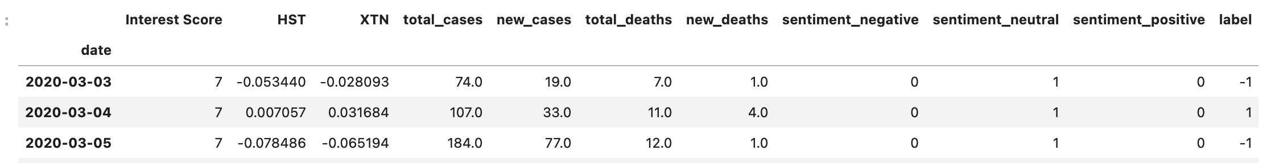
Supervised Learning - Dataset
HST: Host Hotels & Resorts, Inc. is an S&P 500 company and is the largest lodging REIT.
XTN: The S&P Transportation Select Industry Index represents the transportation segment of the S&P Total Market Index (“S&P TMI”).
Interest Score: Google search trends on COVID
Sentiment: Twitter sentiment based on usage of the "COVID" word for the day. Results are obtained by applying VADER sentiment analysis to 1000 tweets per day.
Total_cases: Total COVID cases since inception.
New_cases: Number of new cases reported for the day.
Total_deaths: Total deaths since inception.
New_deaths: Number of new deaths reported for the day.
Label: This is the daily percentchange of the S&P index.

Slide 6
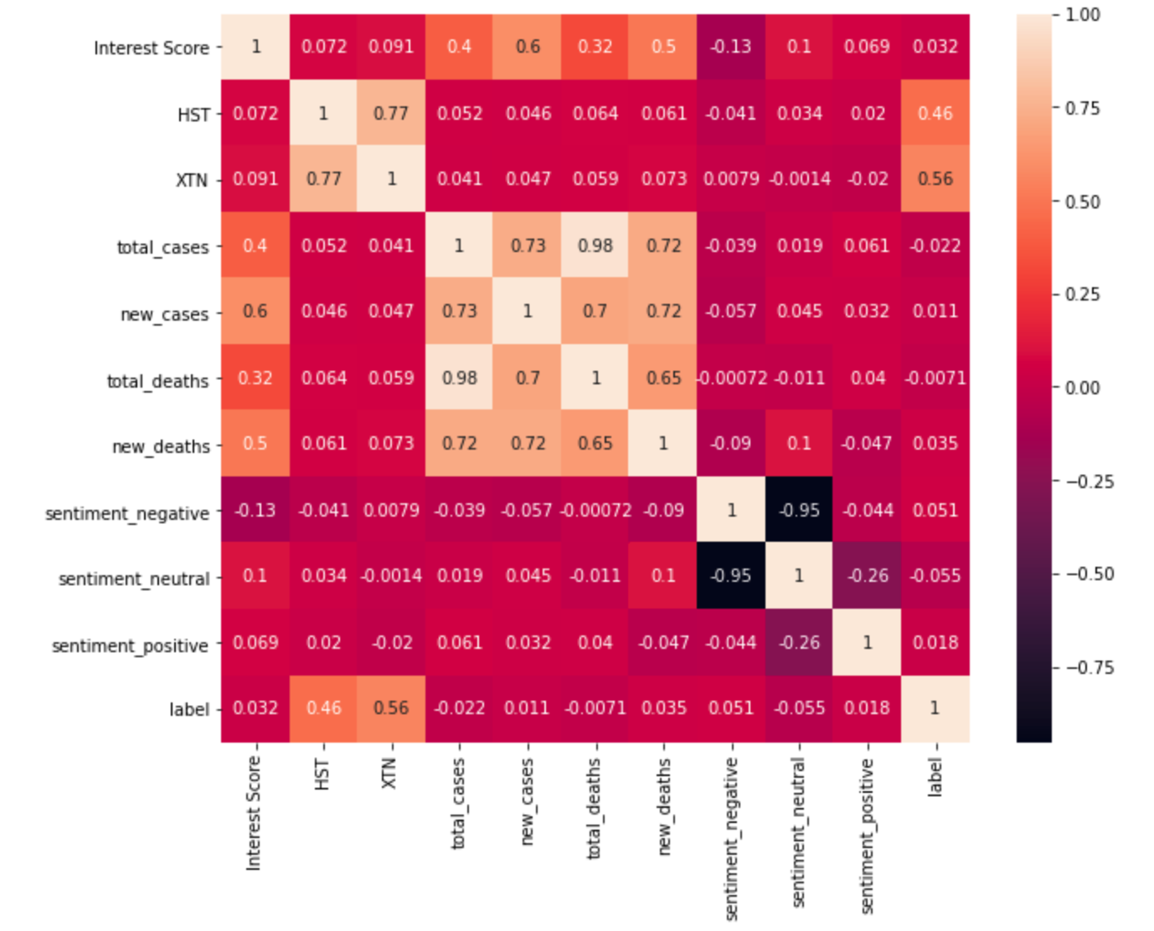
Supervised Learning - Explore
Correlation between Interest Score and COVID stats
Correlation between HST and XTN with the label column (S&P index percentchange)
Correlation between HST and XTN

Slide 7
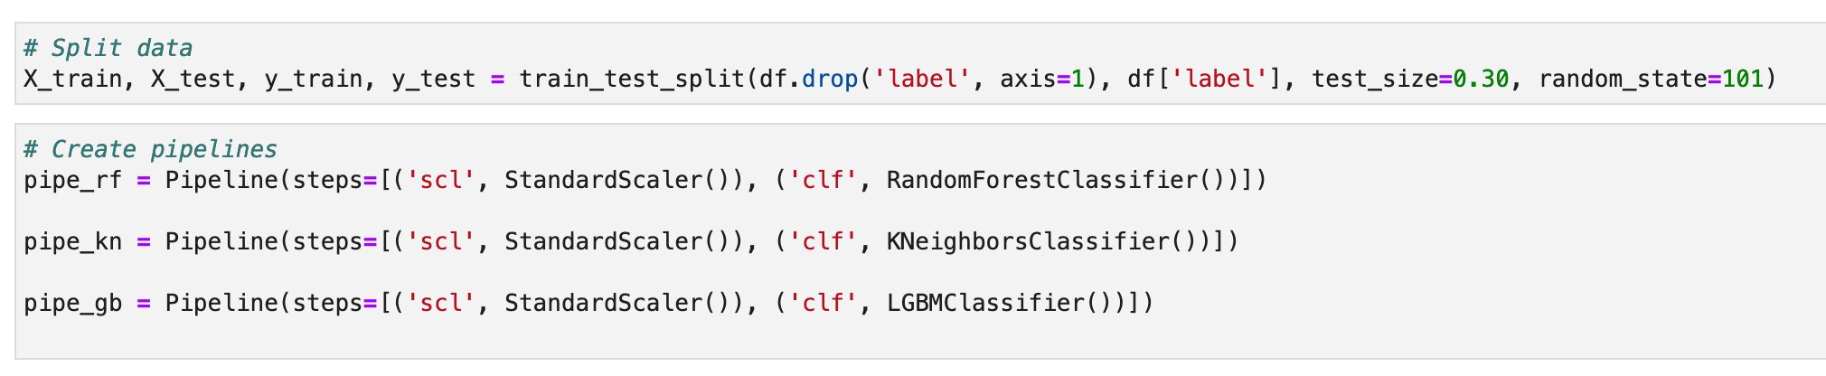
Supervised Learning - Pipeline

Slide 8
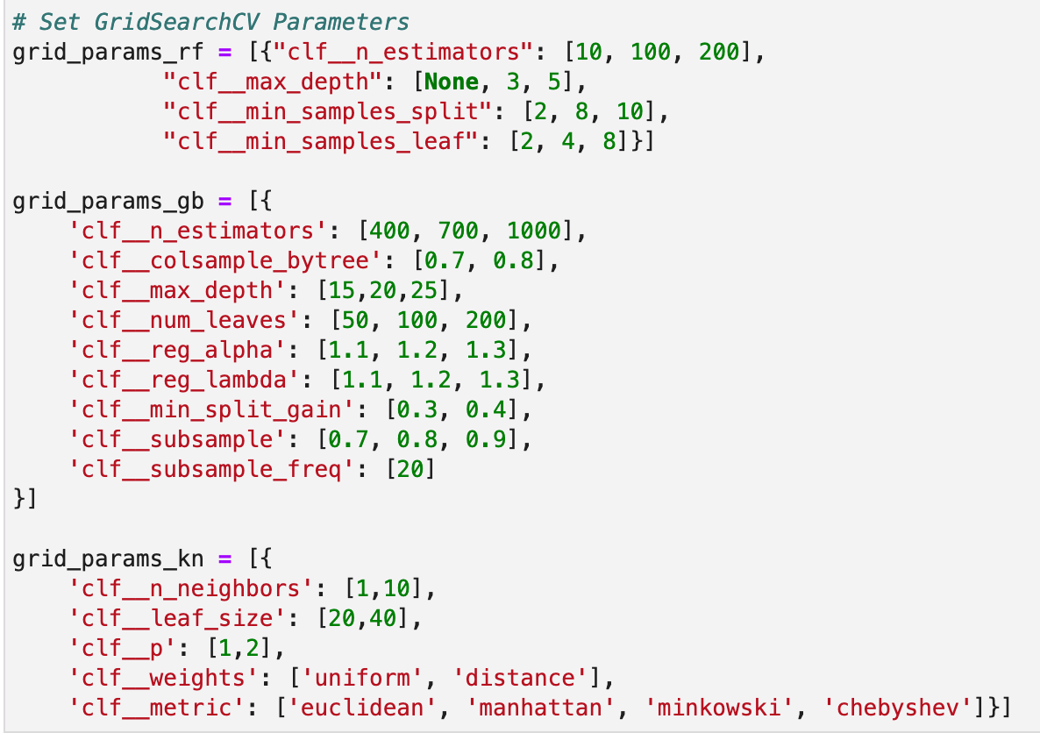
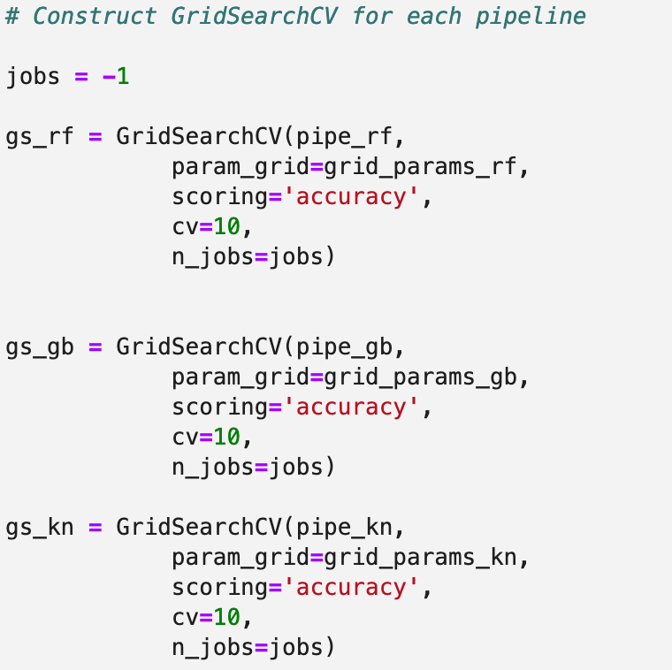
Supervised Learning – Hyperparameter Tuning

Slide 9
Supervised Learning – Fit and Predict
Fit the model
Best performing parameters
Calculate the best training data accuracy
Perform predictions on test data
Calculate test data accuracy of our model
Print Classification Report
Plot Confusion Matrix
Plot ROC/AUC
Plot Feature Importance

Slide 10
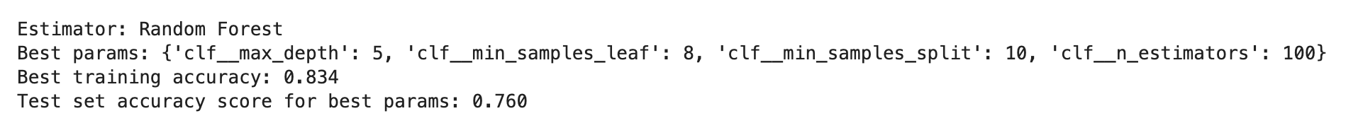
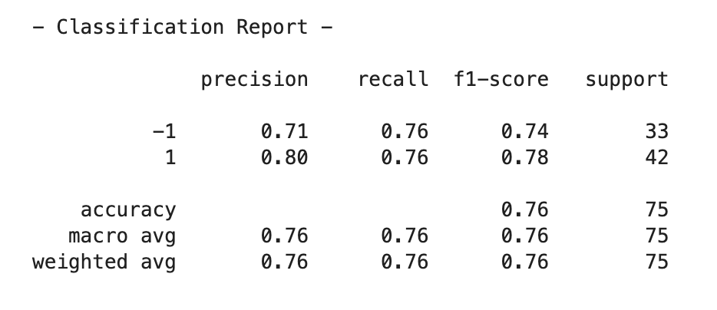
Supervised Learning – Results Random Forest

Slide 11
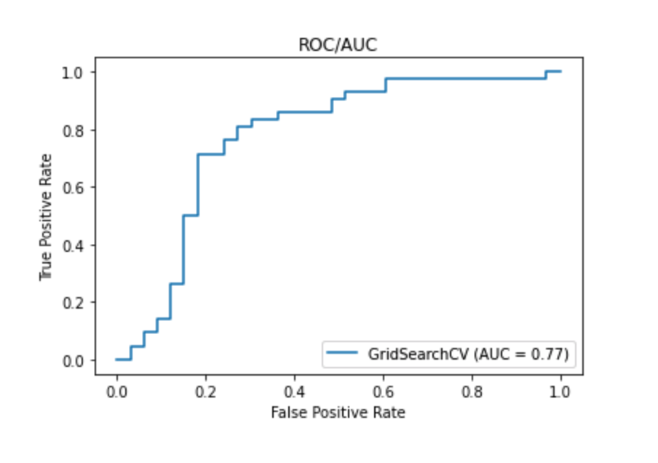
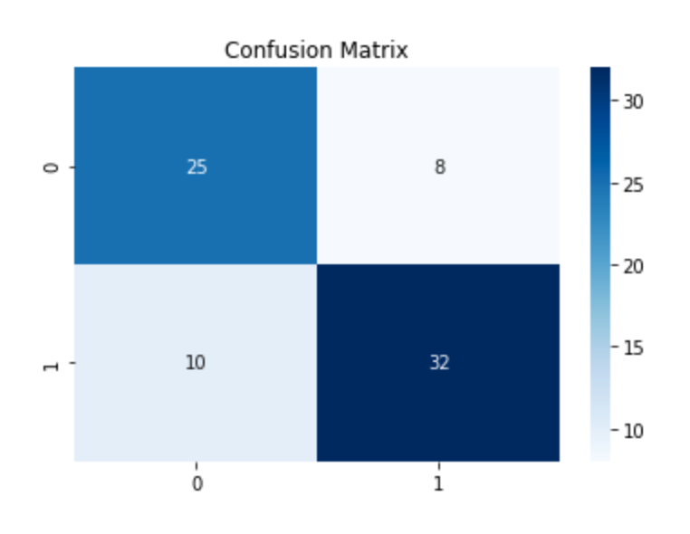
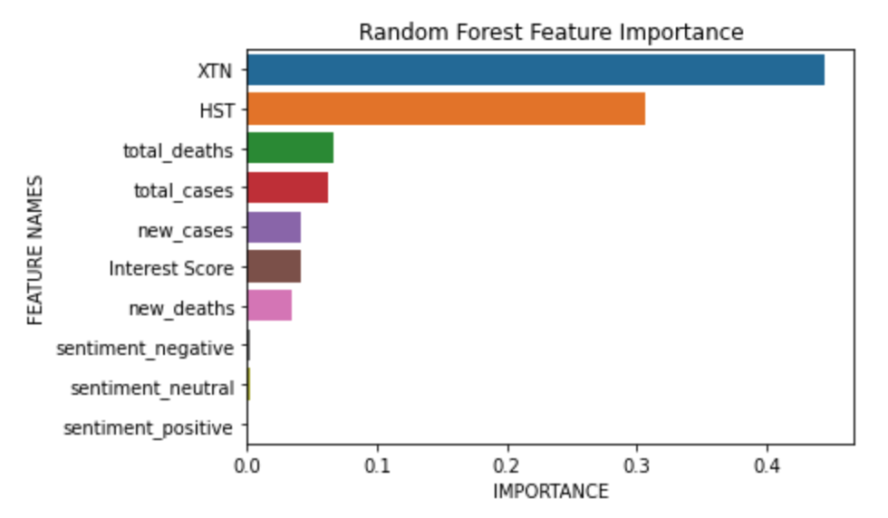
Supervised Learning – Results Random Forest

Slide 12
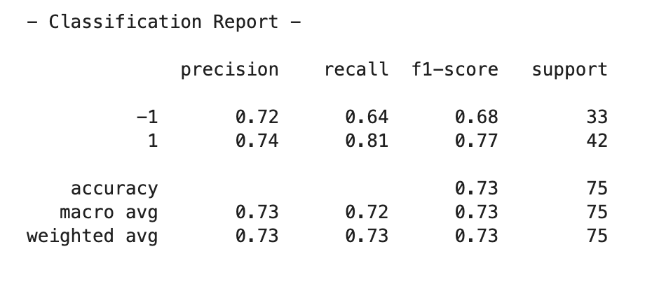
Supervised Learning – Results KNeighbor

Slide 13
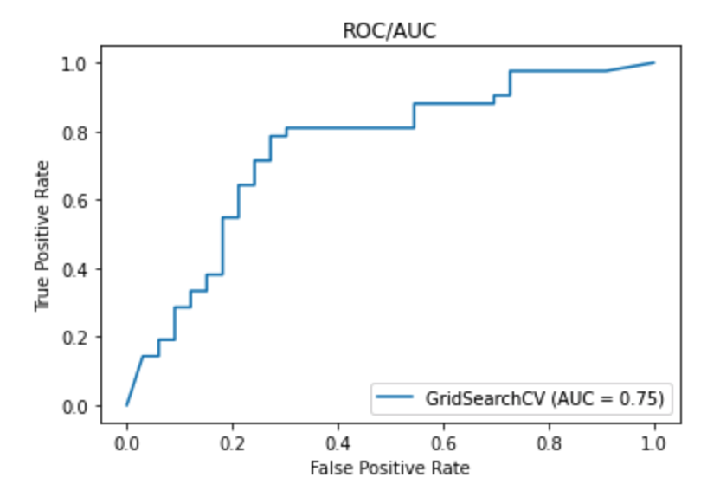
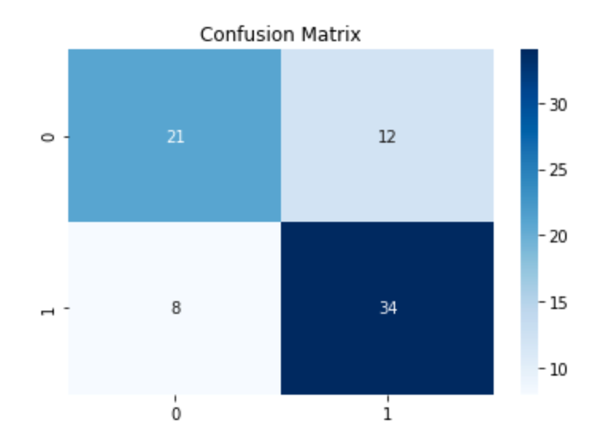
Supervised Learning – Results Kneighbors

Slide 14
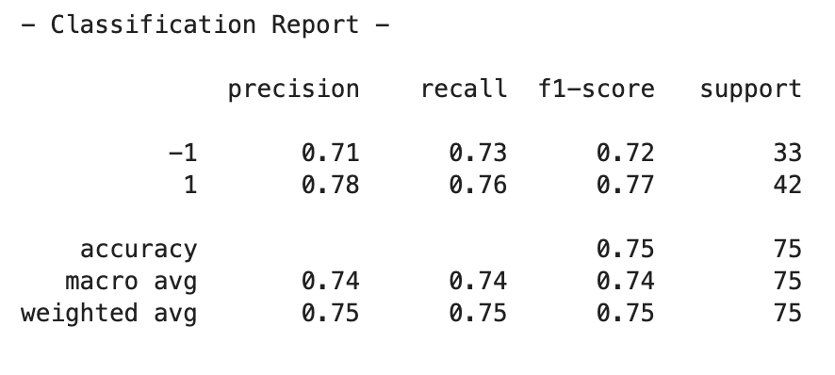
Supervised Learning – Results Gradient Boost

Slide 15
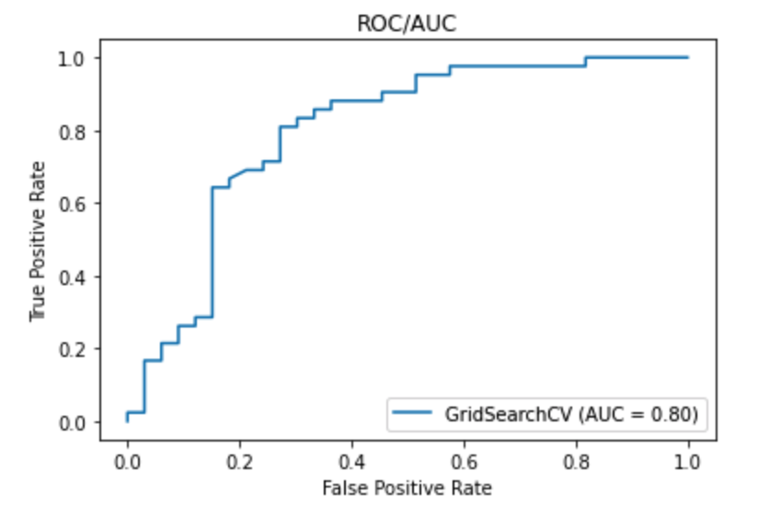
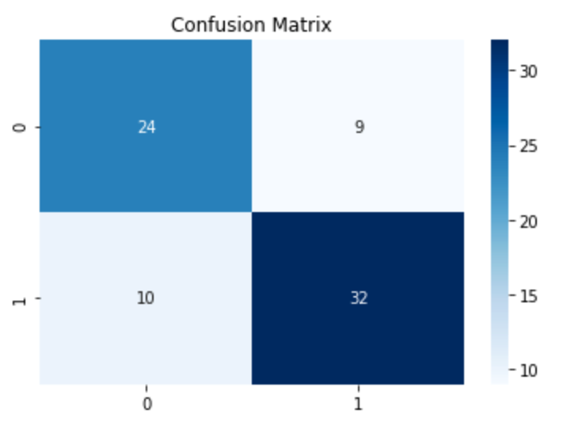
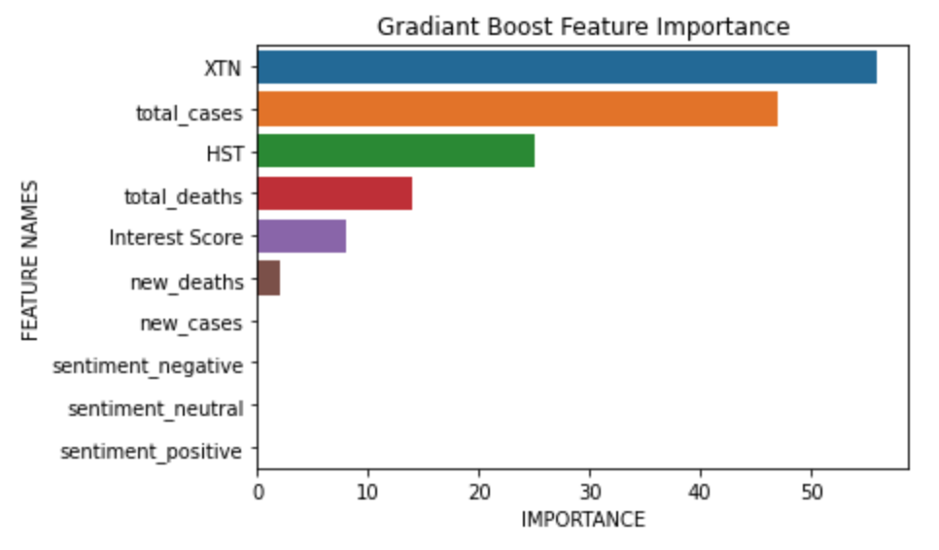
Supervised Learning – Results Gradient Boost

Slide 16
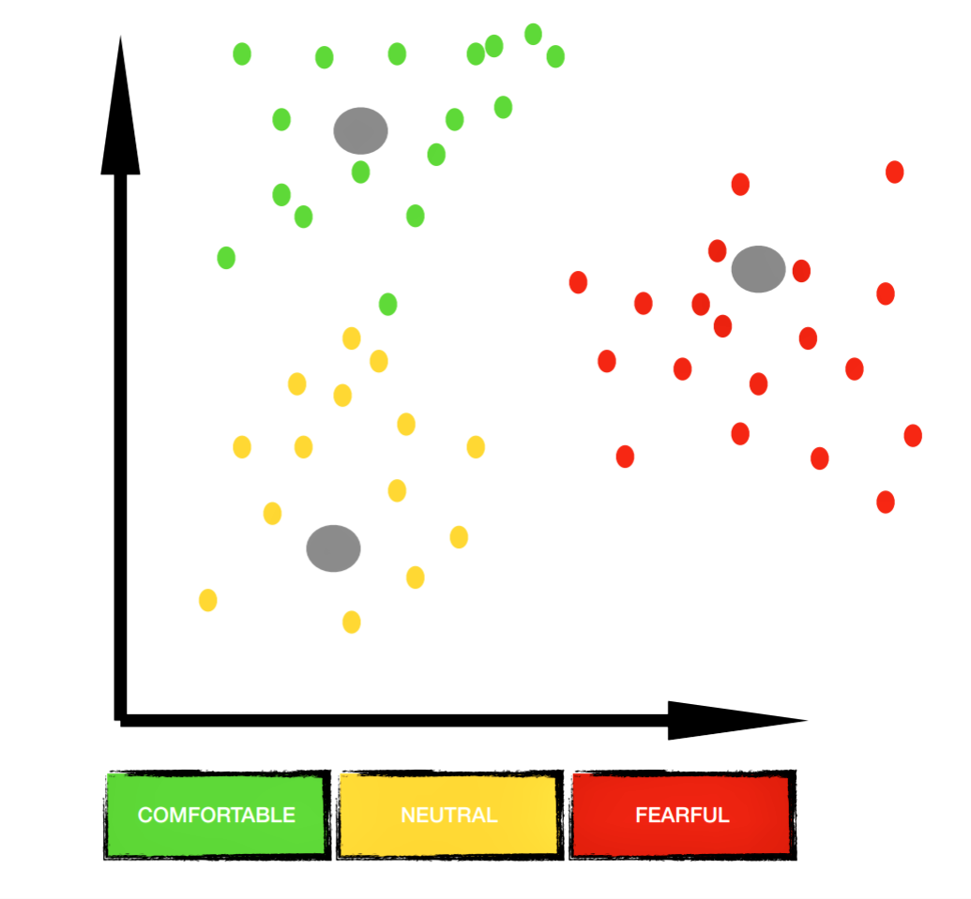
Concept Behind Clustering
Each cluster would represent a sentiment range
Each datapoint would represent a place in that range

Slide 17
Interpreting the Clusters in an Ideal World
Positive Sentiment Centroid
Positive daily return
Positive twitter sentiment
Low google interest score
Neutral Sentiment Centroid
Little to no change
Neutral twitter sentiment
Average google interest score
Negative Sentiment Centroid
Negative daily return
Negative twitter sentiment
High google interest score

Slide 18
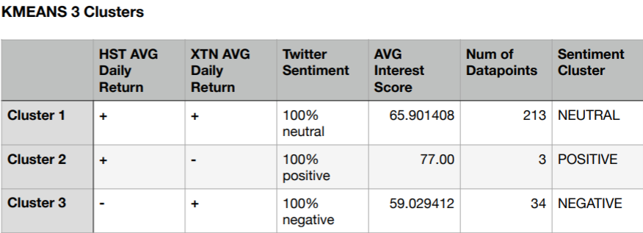
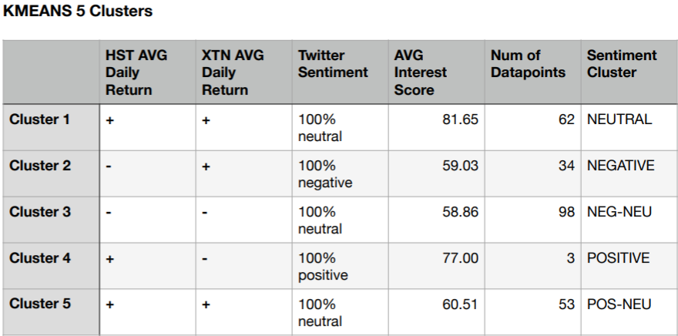
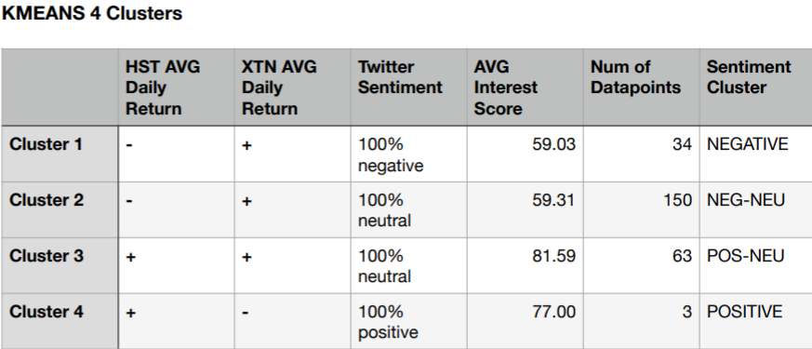
Interpreting the Actual Clusters
Challenge:
Analyzing data points in each cluster to accurately assign a sentiment to each cluster.

Slide 19
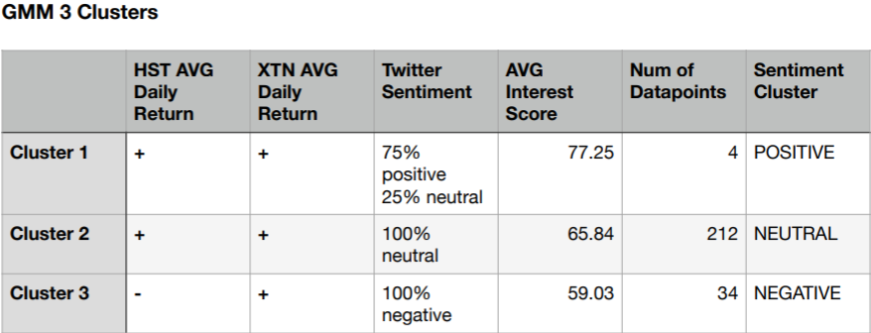
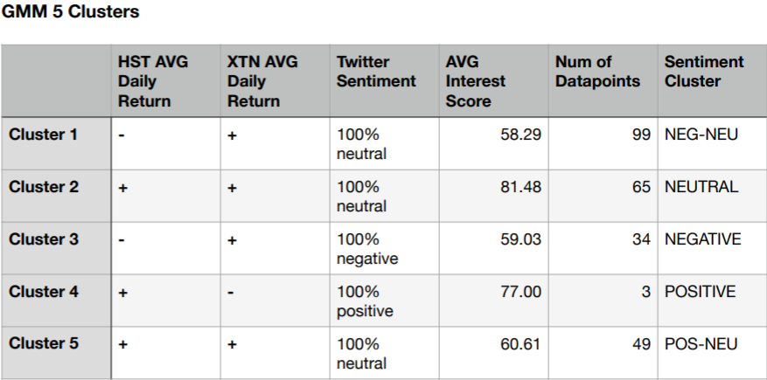
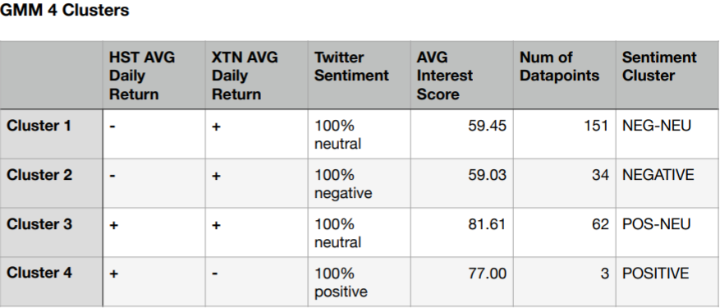
GMM VS K-Means
K-means is a distance based clustering model while GMM is a distribution based model.

Slide 20
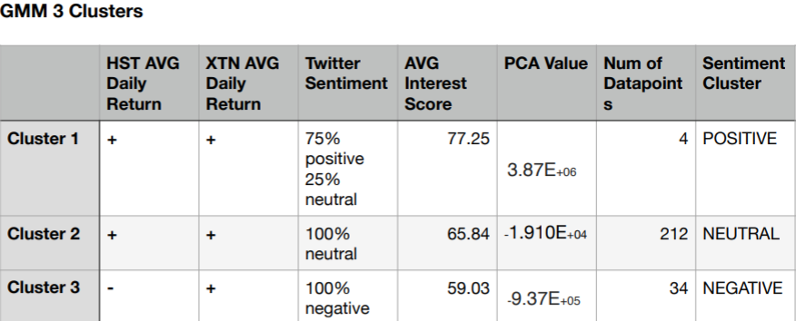
Difficulties Interpreting the Actual Clusters
Determining what means what (e.g. What does a high interest score mean?)
What is the ideal number of clusters to use?
Interpreting the values assigned by PCA

Slide 21
Difficulties and Possible Improvements
Difficulties
Possible Improvements
Limited time range from news API for sentiment analysis. Yourik used snscrape library to get tweets instead of API.
Imbalanced data as Covid generally has a negative sentiment.
Limited timeframe (only one year of data).
Different time frequency (such as stock doesn't trade in weekend and Google interest trend is weekly). Solution is to limit weekend data and duplicate the interest data point for the week.
Difficult to interpret clustering since there are many dimensions.
Get more new data for the sentiment analysis using keywords such as "vaccination", "vacation", "hangouts", and etc.
Include more data that indicates people's fear and comfort level such as "unemployment rate", "eviction", and etc.
Explore if model can be used to predict industry specific stock such as media or other data such as number of flights.
Figure out the formula for the fear and comfort index scale.

Slide 22

QUESTIONS??

